Slide 1
Human Computer Interaction
Lecture 1

Slide 2
The best way to reach me is through e-mail:
Gulmina.rextina@comsats.edu.pk

Slide 3
Central Concept:
Users use interfaces to accomplish a task

Slide 4
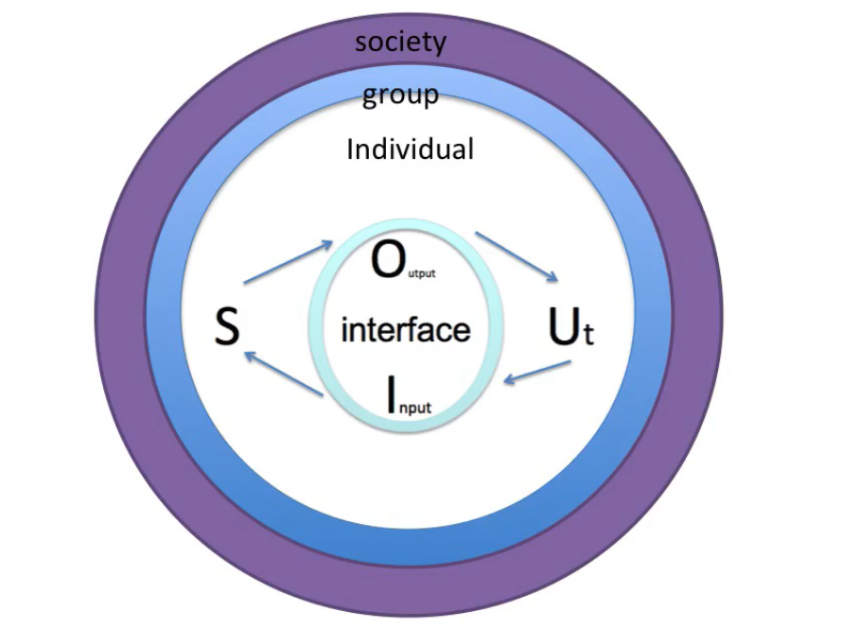

User Experience

Slide 5
Design
The development of a novel creation to meet some need
It does not have to be unique
No harm in reusing

Slide 6
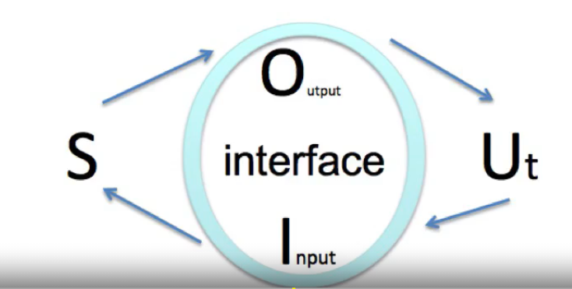
Goal
To create products whose form, content, and behavior are useful, usable, and desirable, as well as economically viable and technically feasible
Useful: S actually produces O
Usable: how efficiently,
effectively and with satisfaction can
the user accomplish the task
Easy to understand
O accomplishes the task.

Slide 7
Why HCI?
HCI stands for Human Computer Interaction….
So what are we trying to achieve by studying this course.
“If we design and develop digital products in such a way
that the people who use them can easily achieve their goals, they will be satisfied, effective, and happy.”
That seems simple enough … yet many products are frustrating to use.

Slide 8
Why HCI?
Can you think of any products that you have used and you had a problem using them?
It doesn’t only have to be software.

Slide 9
Also think about a product that is pleasant to use or that does not require a thought
A sign of good design is that you don’t notice them
Its when design fails it is very obvious.

Slide 10
Why HCI?
What about other every day products?
Have you ever pulled a door when it was supposed to be pulled?
Think about your mobiles, TV, fridge.

Slide 11
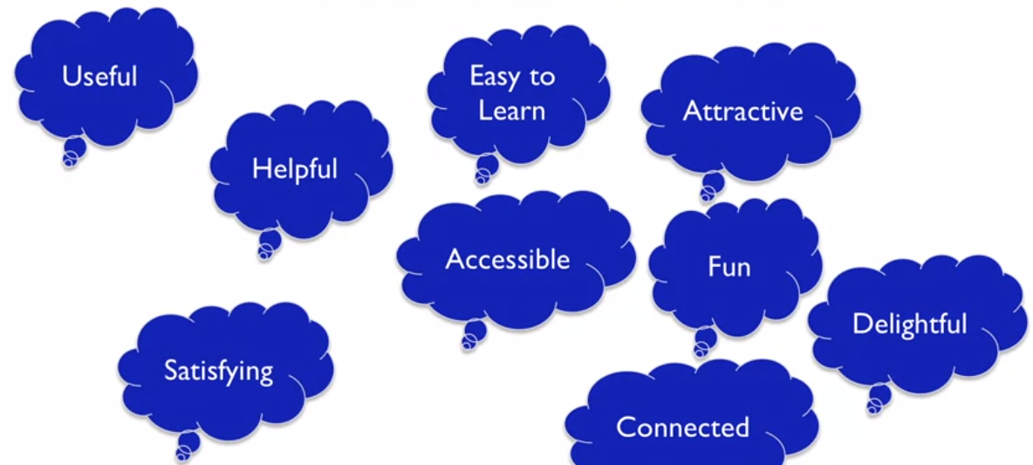
What is Good User Experience?

Slide 12
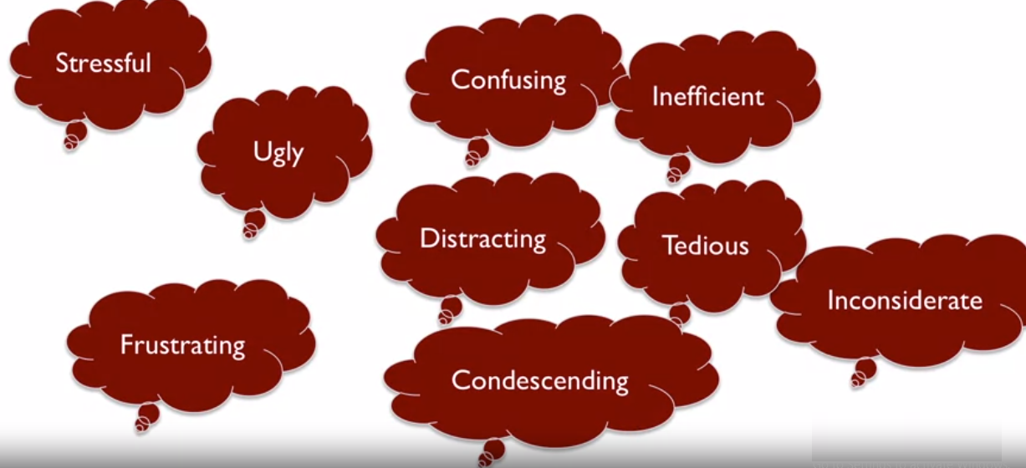
What is Bad User Experience?

Slide 13
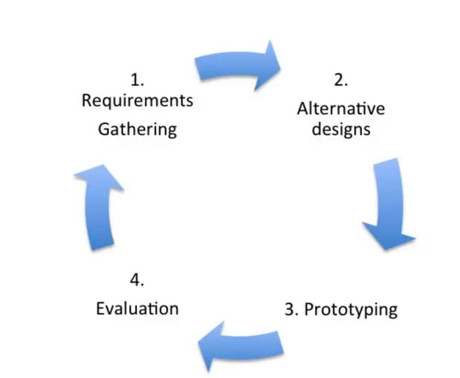
Design Cycle

Slide 14
Why digital products fail?
Four main reasons
Misplaces Priorities– on the part of both management and developers
Ignorance about real users
Conflicts of interest
Lack of design process

Slide 15
Misplaces Priorities
Marketers
Chasing competition
Making guesses based on surveys
Developers
Have a lot of say regarding what actually gets built.
Have tight deadlines and confusing input about what needs to be built

Slide 16
Ignorance about real users
Who will use the product?
Why would they want to use it?
How will they use it?
What are there goals?

Slide 17
Conflict of Interest
Developers should not be designers.
Why?

Slide 18
Lack of Design Process
Processes exist but may not be followed
Many companies integrate user input directly into the development…
but users can only identify problems but often can not specify the solution

Slide 19
Context of HCI
Where can we apply HCI?
Anything with an interface

Slide 20
Context of HCI
That includes
Websites
Desk top applications
Mobile apps
Coffee machines
Vending machines
Software in an airplane
…
…
..
.

Slide 21
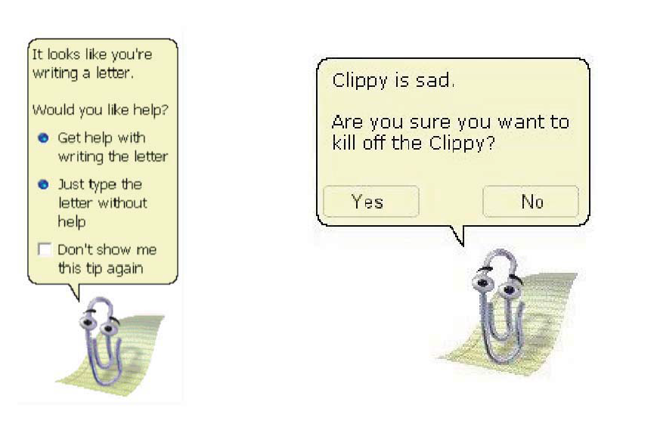
Good or Bad Interface?

Slide 22
Why is Good Interaction Design Important?
Users time isn’t getting any cheaper
A company may save lots of money by reducing the time it takes it workers to do a task
Few attempts to use any product
If not successful
Loses hope
Gives up
Disasters can occur
Examples
Three Mile Island
Air Inter Flight 148,

Slide 23

Three Mile Island
1979, Pensulvania

Slide 24
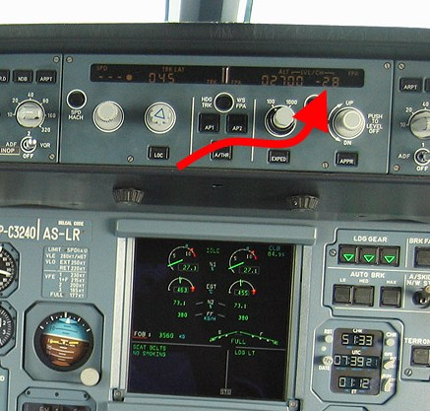
Air Inter Flight 148
http://blog.martindoms.com/2011/01/24/poor-ui-design-can-kill/

Slide 25
Why are User Interfaces Hard to Design
You are not the user
It is very hard for designers to put themselves in place of the user to understand how they will perceive things
Users are right
If people keep making the same mistakes with your design it’s the fault of the design not the users
But users are not designers
They don’t always know what they want
1950’s telephone study
Google results per page
10, 20 or 30 results per page

Slide 26
So What is Usability
Dimensions of Usability
Learnability
Efficiency
Visibility of system Status
Errors Prevention
Satisfaction
All of these are measurable, just as we can say that Algorithm X is more efficient then Algorithm Y we can say Interface X is more Learnable than interface Y

Slide 27
Which Dimension of Usability is more Important?
…. Depends on the user
New users would need learnability more
Experts need efficiency
Infrequent users need memorability
But no user is completely novice or expert

Slide 28
Why Study HCI?
To develop products / interaction techniques
Easy to use
Easy to learn
Easy to remember
To design user friendly systems
Efficient
Avoid unnecessary complexity

Slide 29
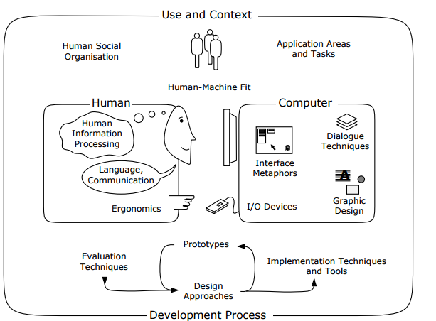
What is HCI?

Slide 30
Software Eng. VS HCI
Software Engineering
System-centered
Software architecture
Human Computer Interaction
User-centered
Users
Tasks
Context of use
procedural aspects

Slide 31
Some HCI Subjects
HCI (in general)
Usability eng./testing
User interface design
Human factors/Ergonomics
Web design/usability
Graphic design
Information visualization
Many more…

Slide 32
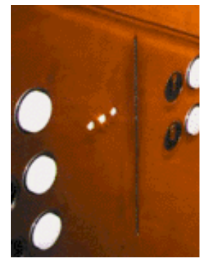
What is wrong with the following

Slide 33
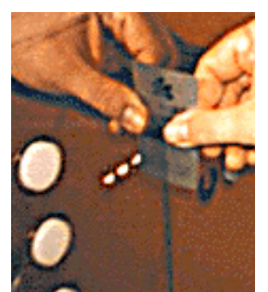

Slide 34
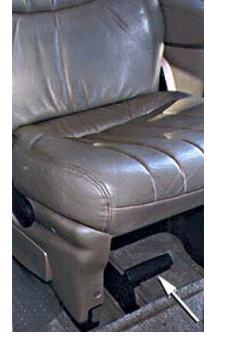

Slide 35
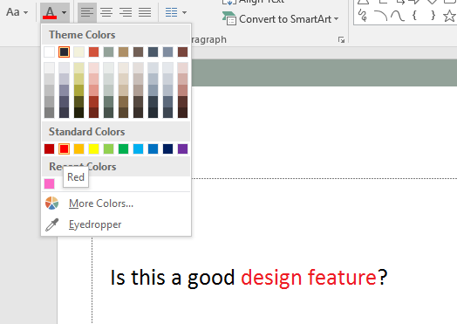
Good or Bad Design

Slide 36
Course Learning Outcomes
Upon completion of the course, students will be able to:
Sr.# | Unit# | Course Learning Outcomes | Blooms Taxonomy Learning Level
CLO-1 | 1 | Recognize the principles & conceptualizing interaction for human-centered software development. | Understanding
CLO-2 | 2 | Apply Human centered data gathering processes. | Applying
CLO-3 | 3 | Design an application using modern human-centered principles. | Applying
CLO-4 | 4 | Implement usability tests for an existing software application. | Applying
CLO-5 | 5 | Discuss the cognitive and social aspects that influence interaction design. | Understanding

